Slide 1


Welcome to the FoodEducators
Info Webinar
Teacher’s Training Workshop

Slide 2

Your organisation
Short presentation of your organisation
Your vision
Short presentation of your organisation’s goals and objectives, activities…

Slide 3
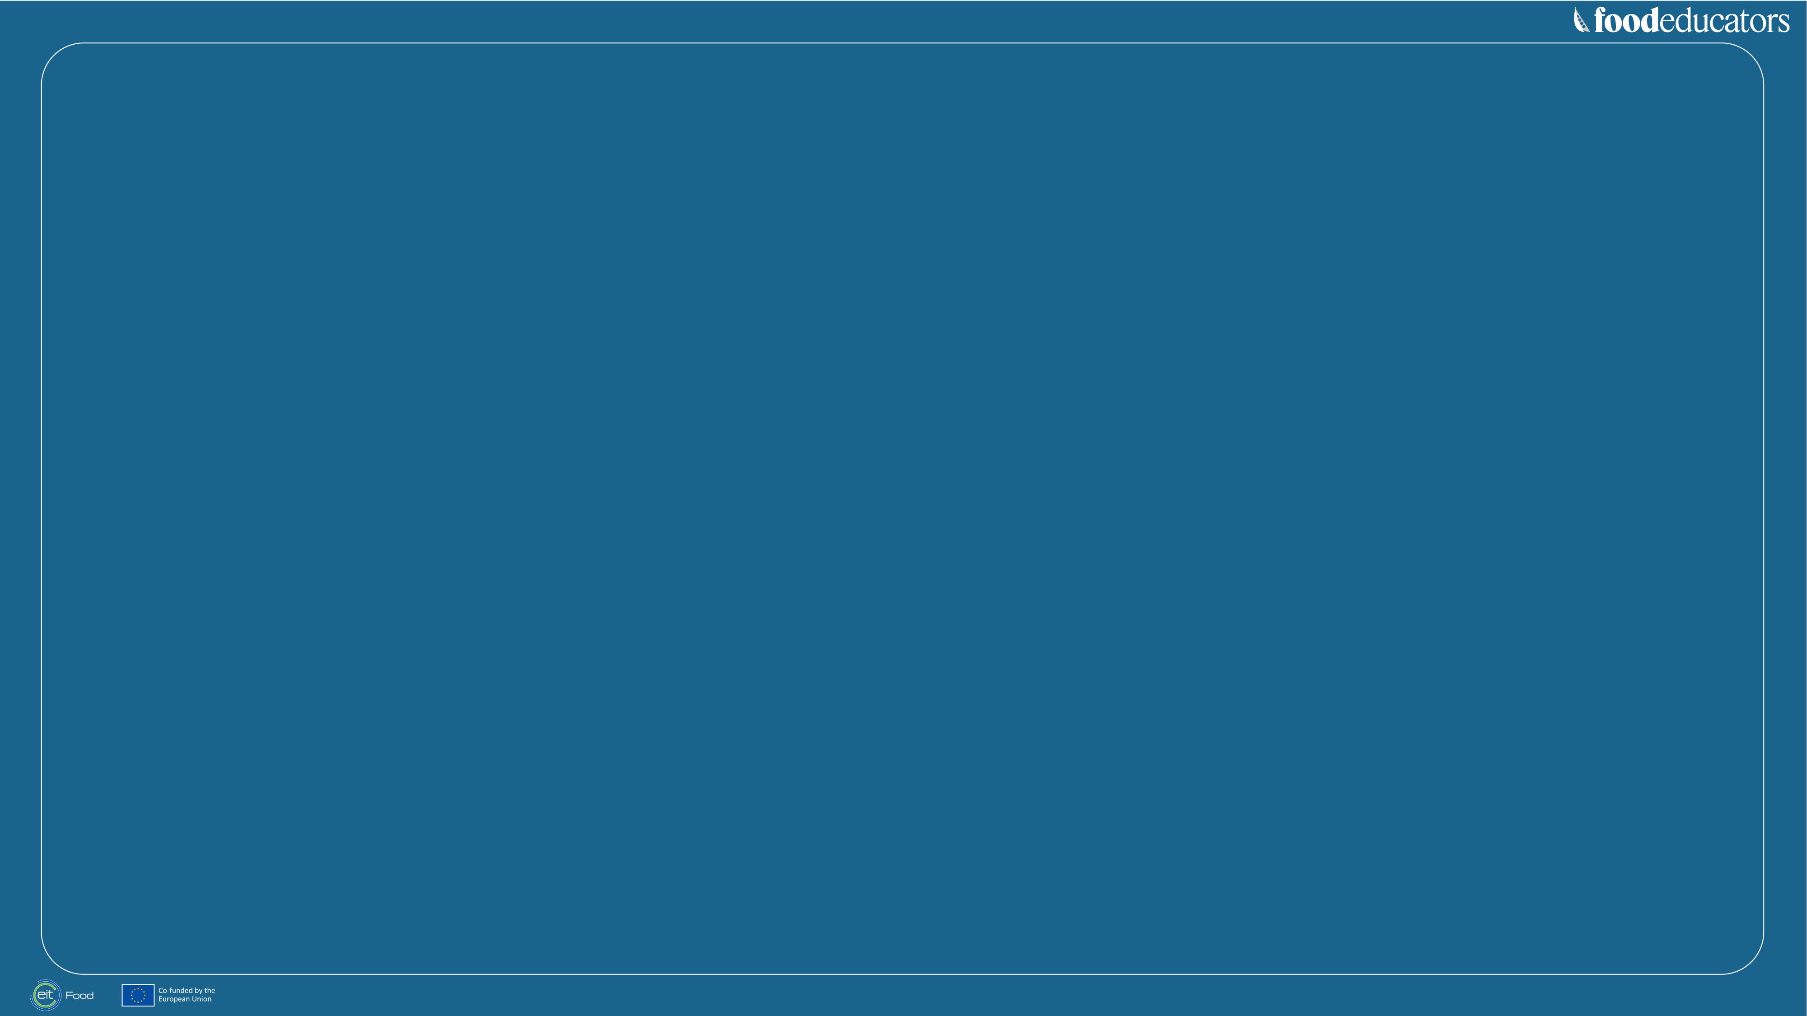
Agenda
1 Why is there a need for Food Education?
2 Introduction of EIT Food
4 Our Learning objectives and Offer
5 Our Partners and Activities
6 Our Lesson plans
8 Discussion about Implementation

Slide 4
Why is there a need
for Food Education?

Slide 5
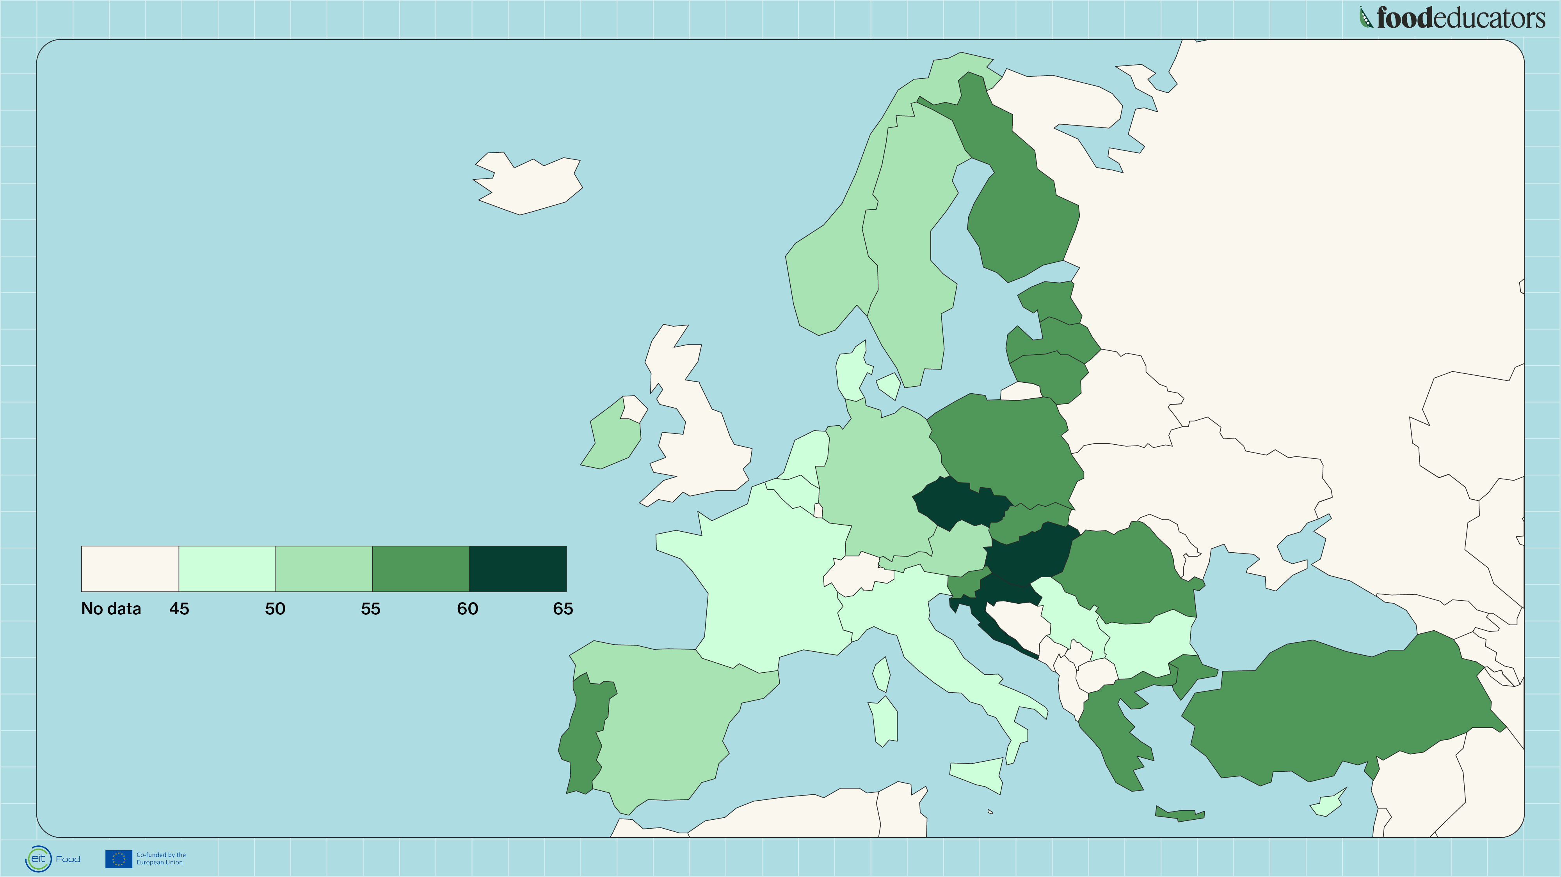
Overweight population
% of adult population, 2019
European Union 53%
Body mass index is calculated
as person’s weight divided
by the square of height
Source: Eurostat

Slide 6
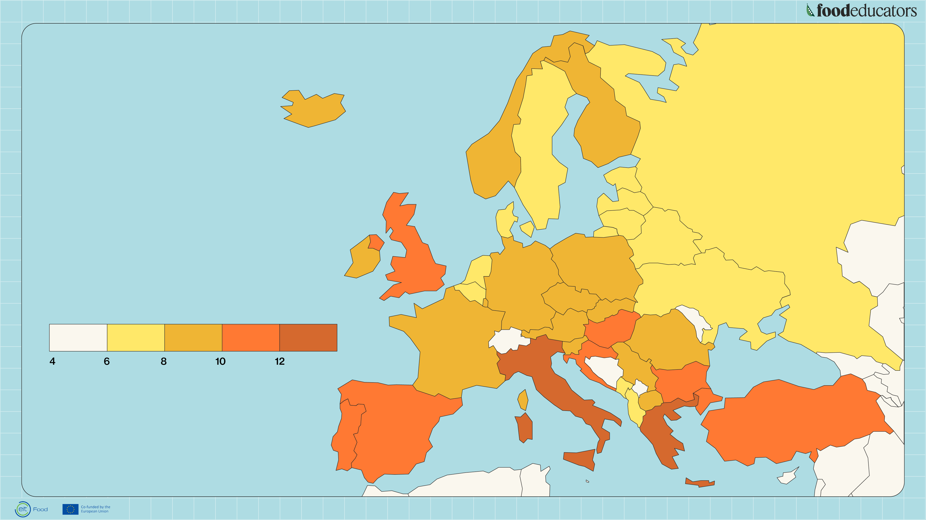
Childhood obesity
% of children (5-19), 2016
Source: World Health Organisation

Slide 7
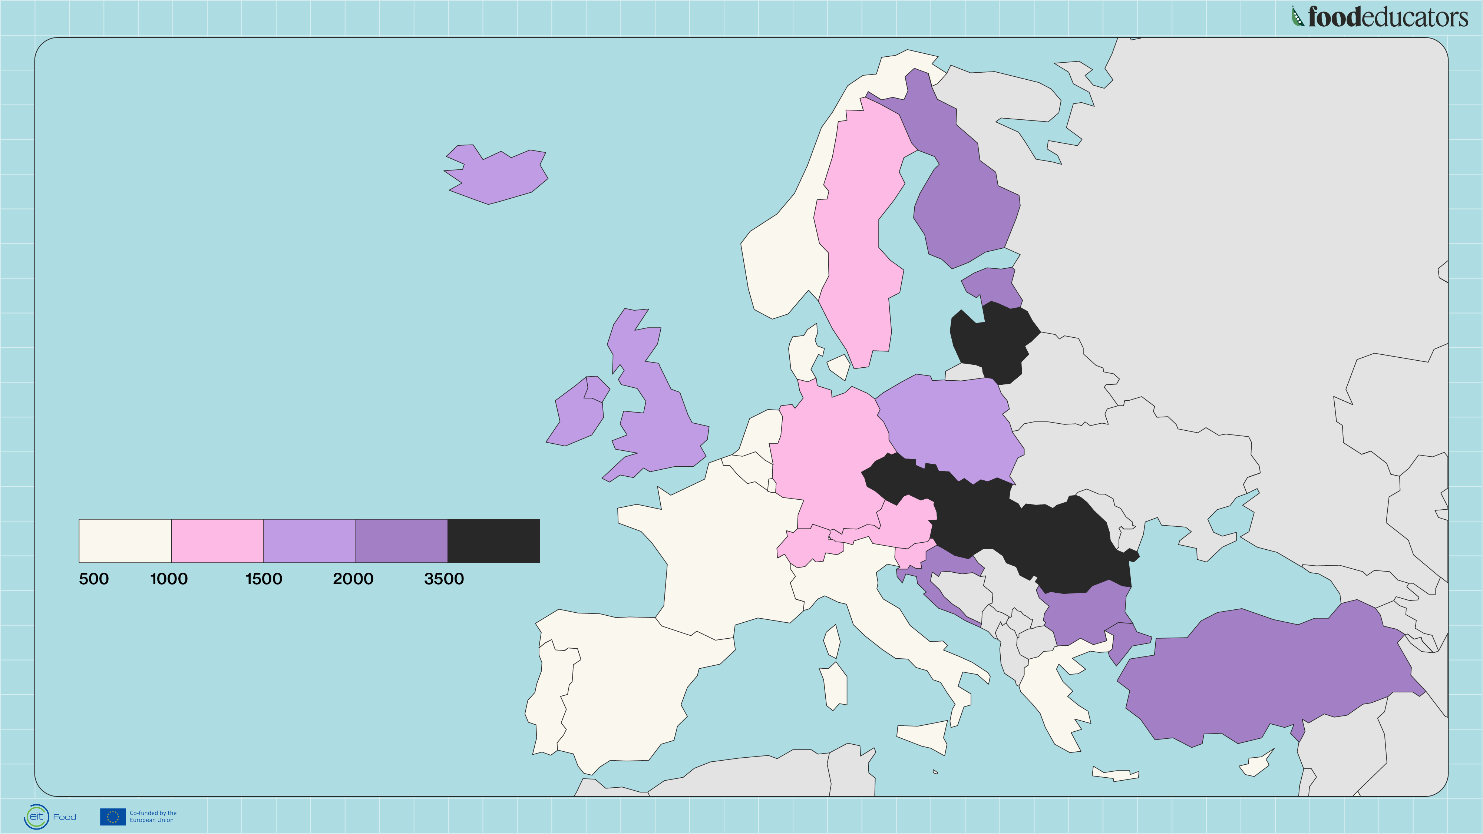
Deaths due to
coronary diseases
deaths per million inhabitants
per country, 2017
Source: Eurostat

Slide 8
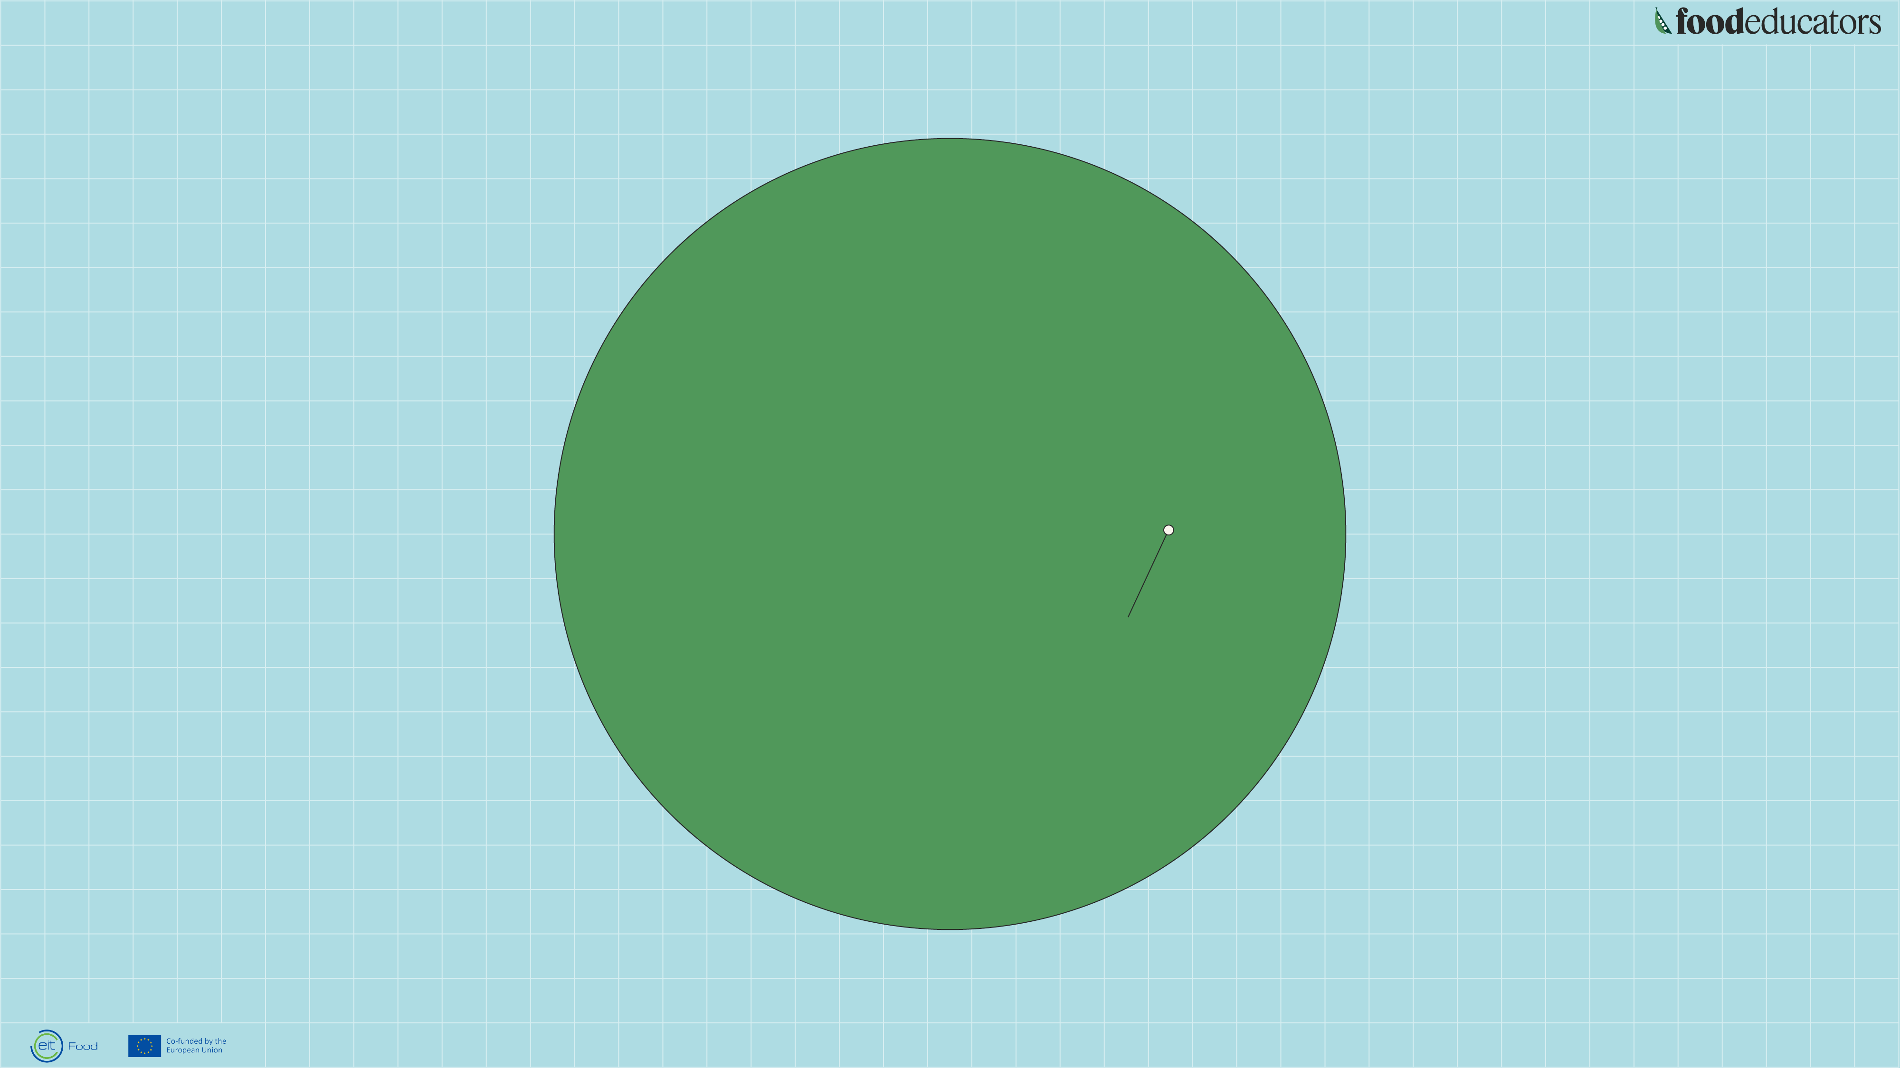
If all of human history
so far had lasted a day,
how old would our
current food system be?
One day, or 86400 seconds
4 seconds
If human history so far had
lasted one day, our current
food system would have been
around for less than 4 seconds.

Slide 9
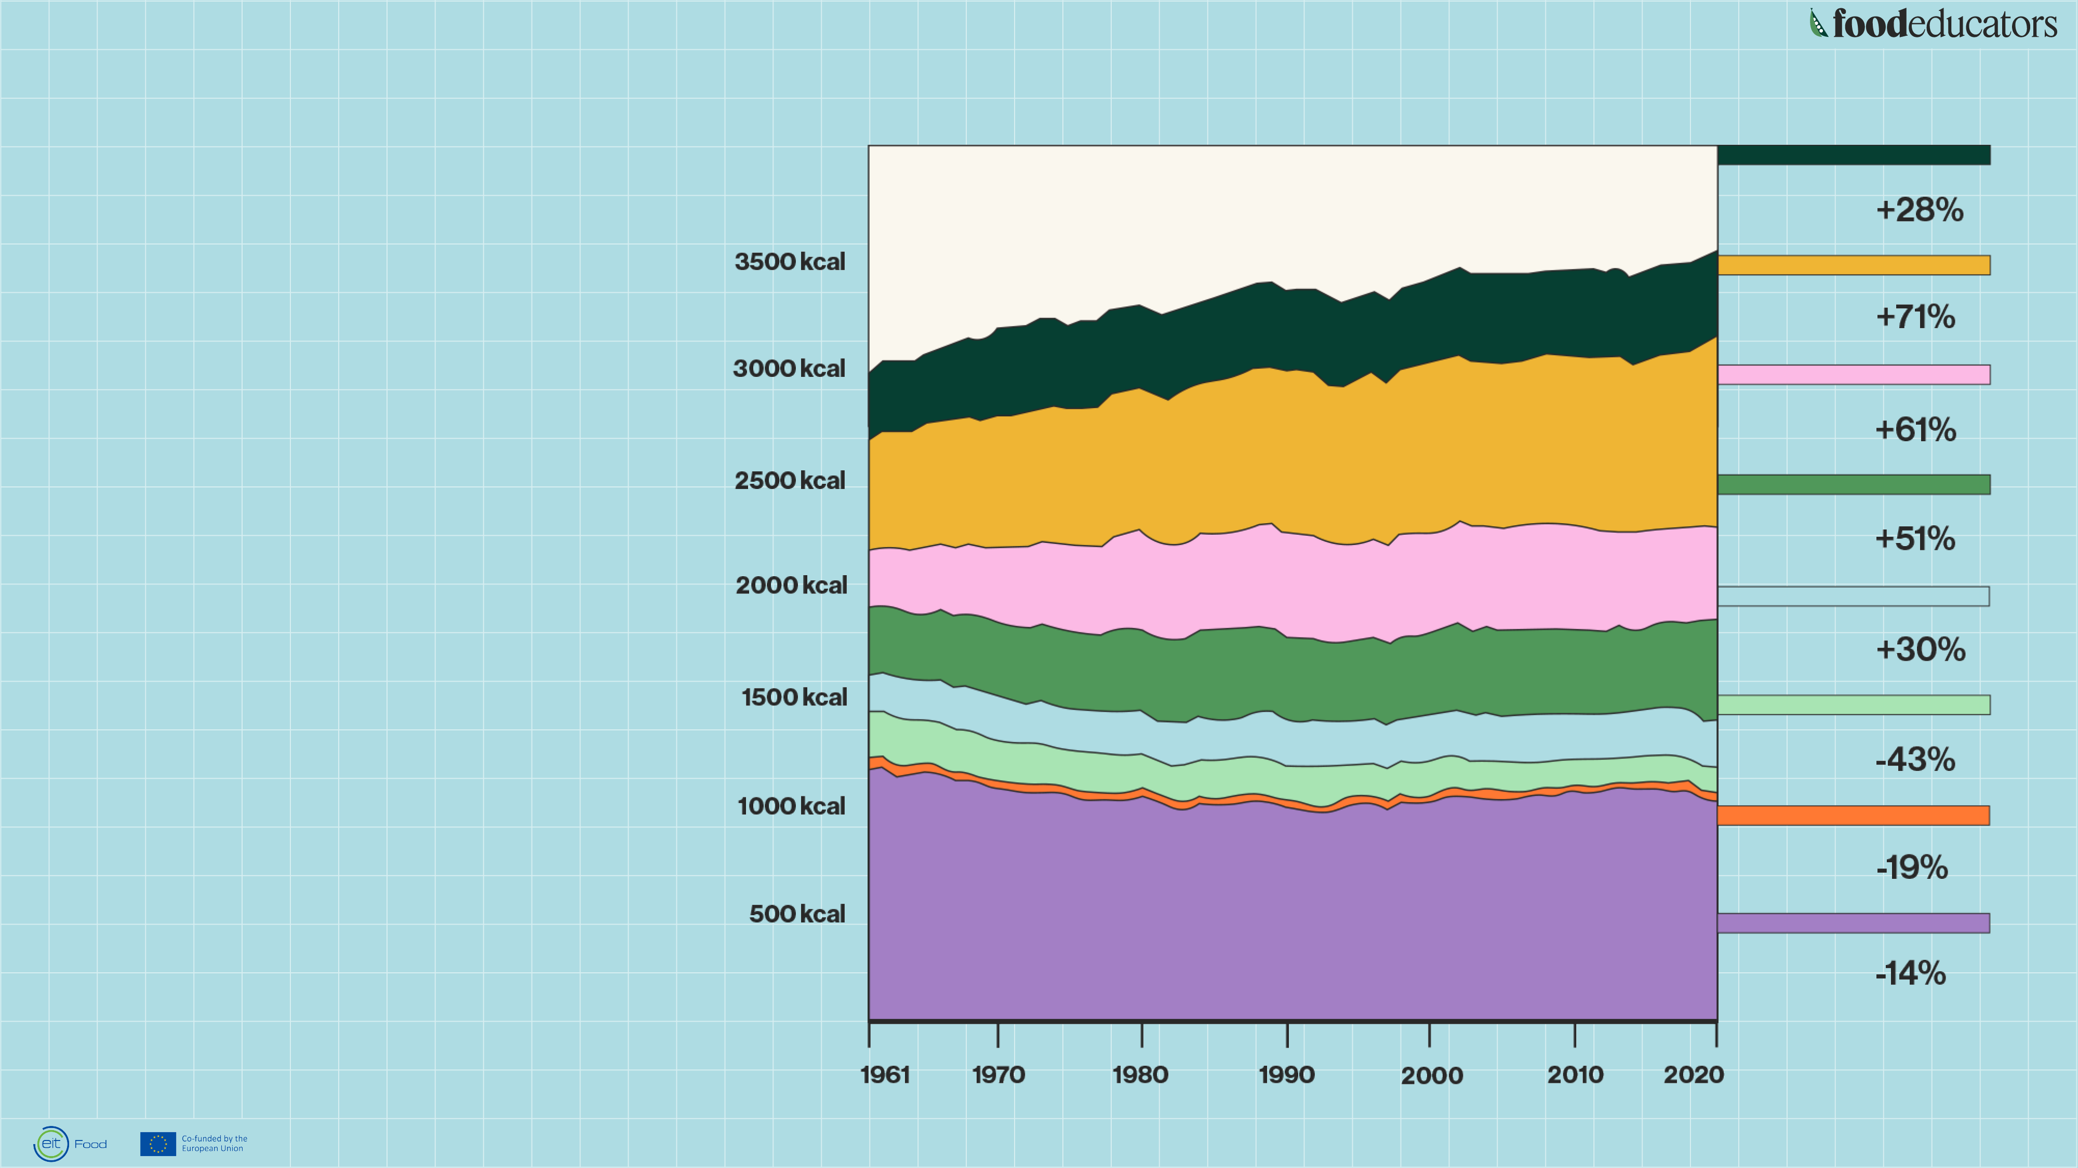
How has the European diet
change since 1961-2020?
We are eating
more calories
and animal
-based products.
SUGAR
OIL&FAT
MEAT
DAIRY
&EGGS
FRUIT
&VEGGIES
STARCHY
ROOTS
PULSES
&BEANS
CEREAL
&GRAINS
Source: FAO

Slide 10
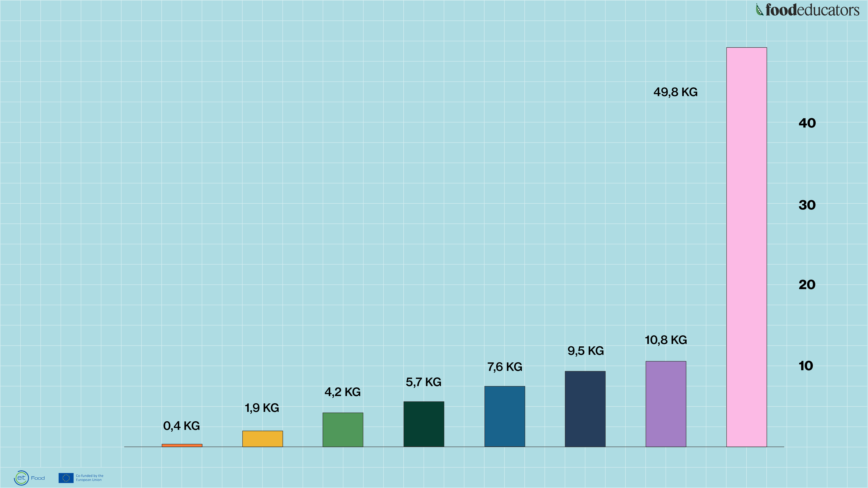
Greenhouse gas emissions
per 100 grams of protein
BEEF
Greenhouse gas emissions are measured in kilograms of carbon dioxide equivalents per 100t grams of protein. This means non-C02 greenhouse gases are included and weighted by their relative warming impact.
Source: Poore, J. & Nemecek, T. (2018) via Our World in Data
CHEESE
MILK
PIG
FISH
EGGS
TOFU
PULSES

Slide 11
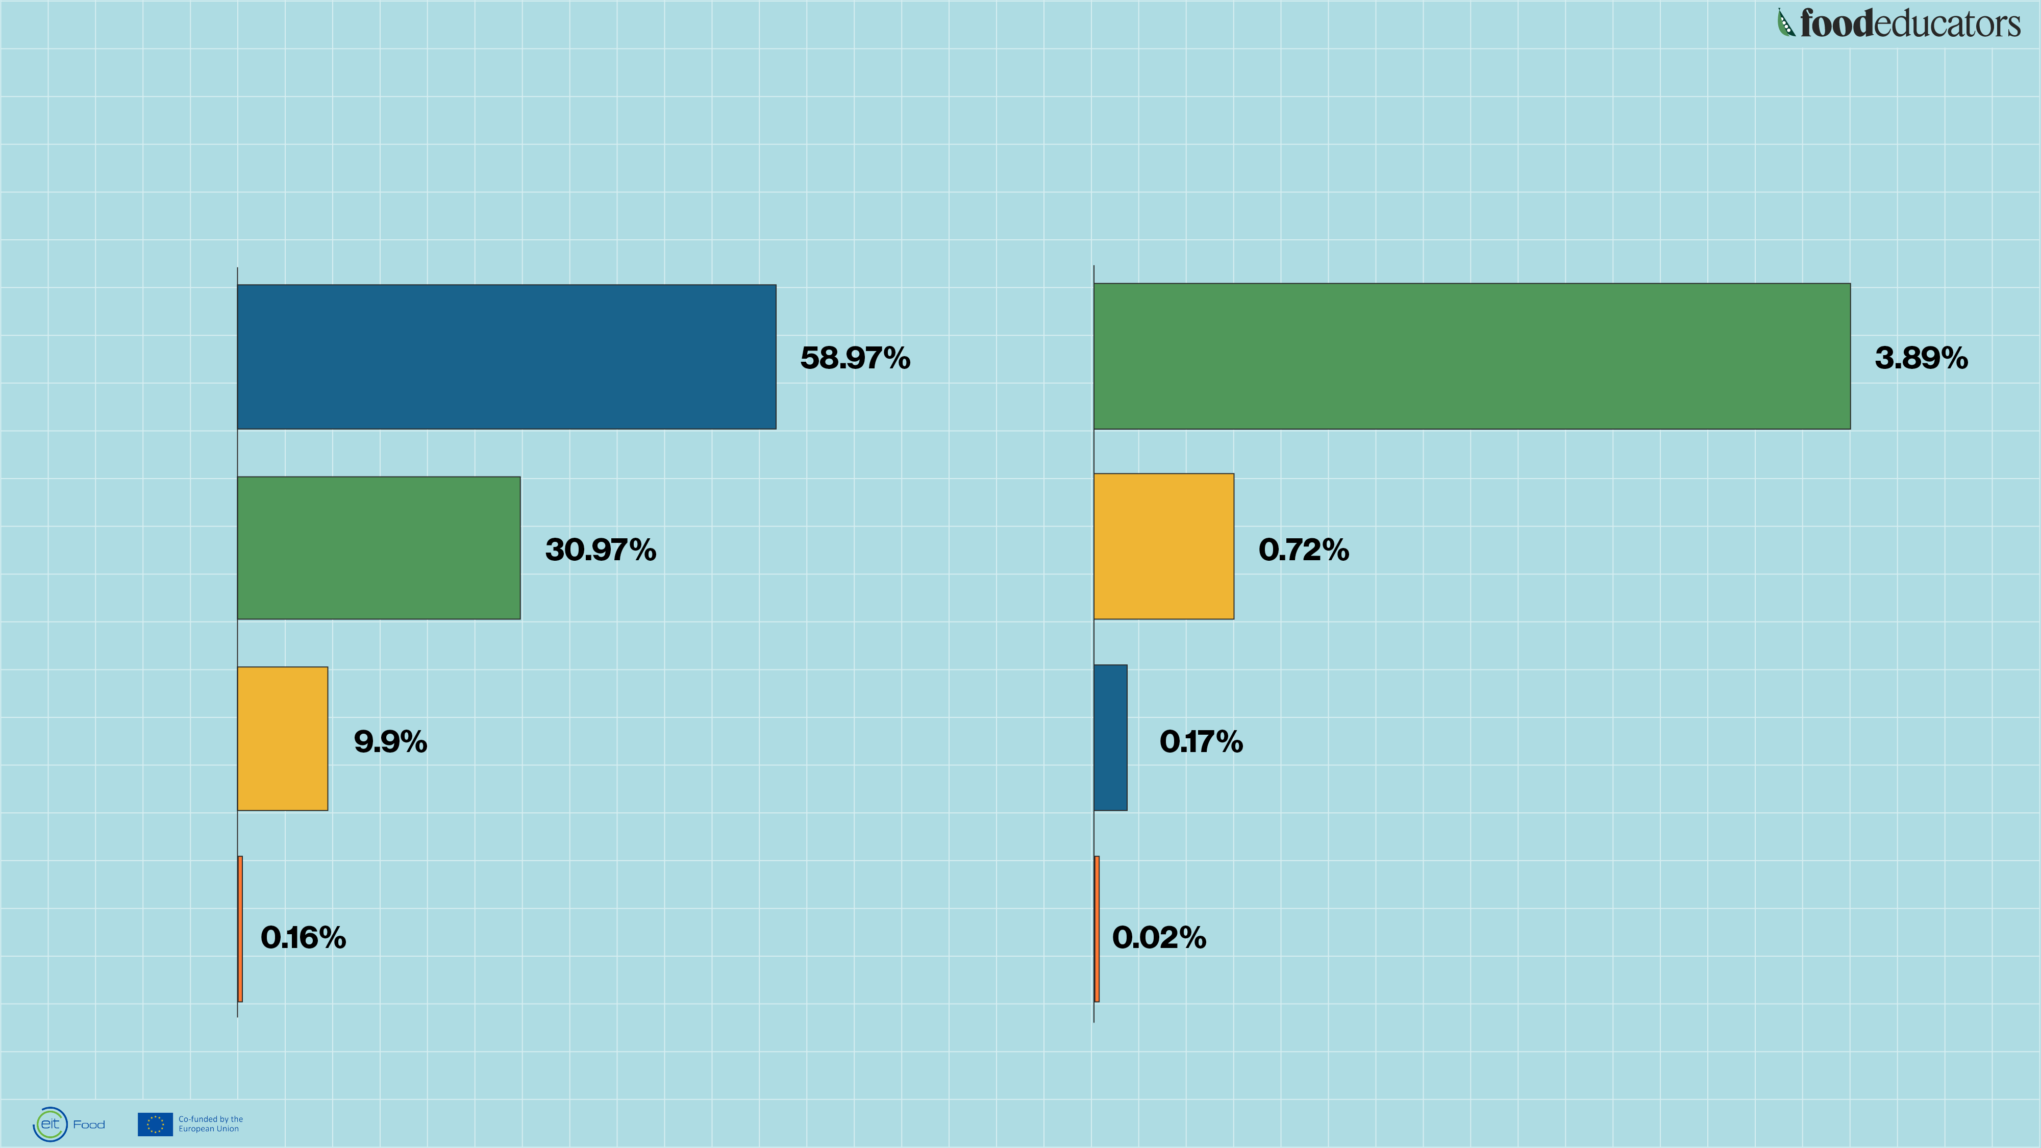
Share of global food miles
by transport method
Transport's share of global greenhouse gas emissions
WATER
ROAD
ROAD
RAIL
RAIL
WATER
PLANE
PLANE
Source: Poore, J. & Nemecek, T. (2018) via Our World in Data

Slide 12
What food-related projects and initiatives are happening in your school?

Slide 13
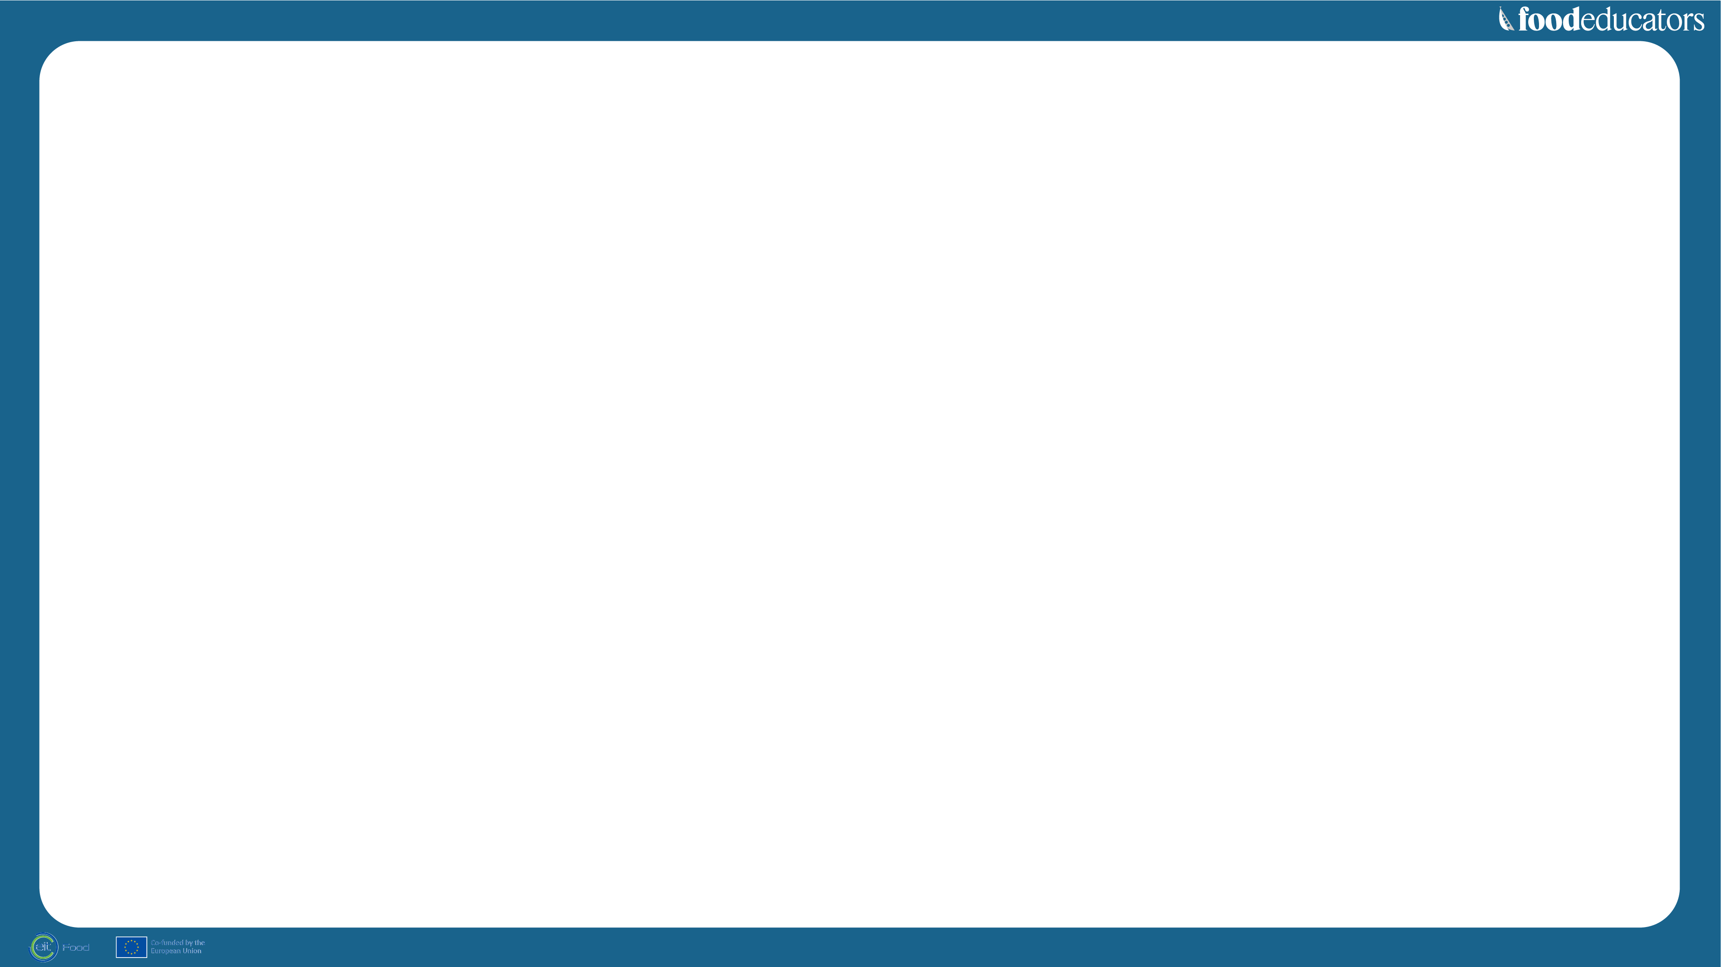




We are building our programme
on educators' needs
Key takeaways
from the teachers’ needs assessment survey in 2022:
→ Teachers would like to use more videos, more games and quizzes as well as live interactions with food stakeholders. ​
→ Most of the sample consulted would like to receive additional materials for their own learning.
→ Teachers use digital tools for teaching and would like to use them more often. ​
→ Existing school programmes are mainly about sustainability very broadly – and focus
on food waste. ​
→ Lack of knowledge
of key concepts –e.g. circular economy, food systems, therefore, they would like support to implement any related materials. ​

Slide 14
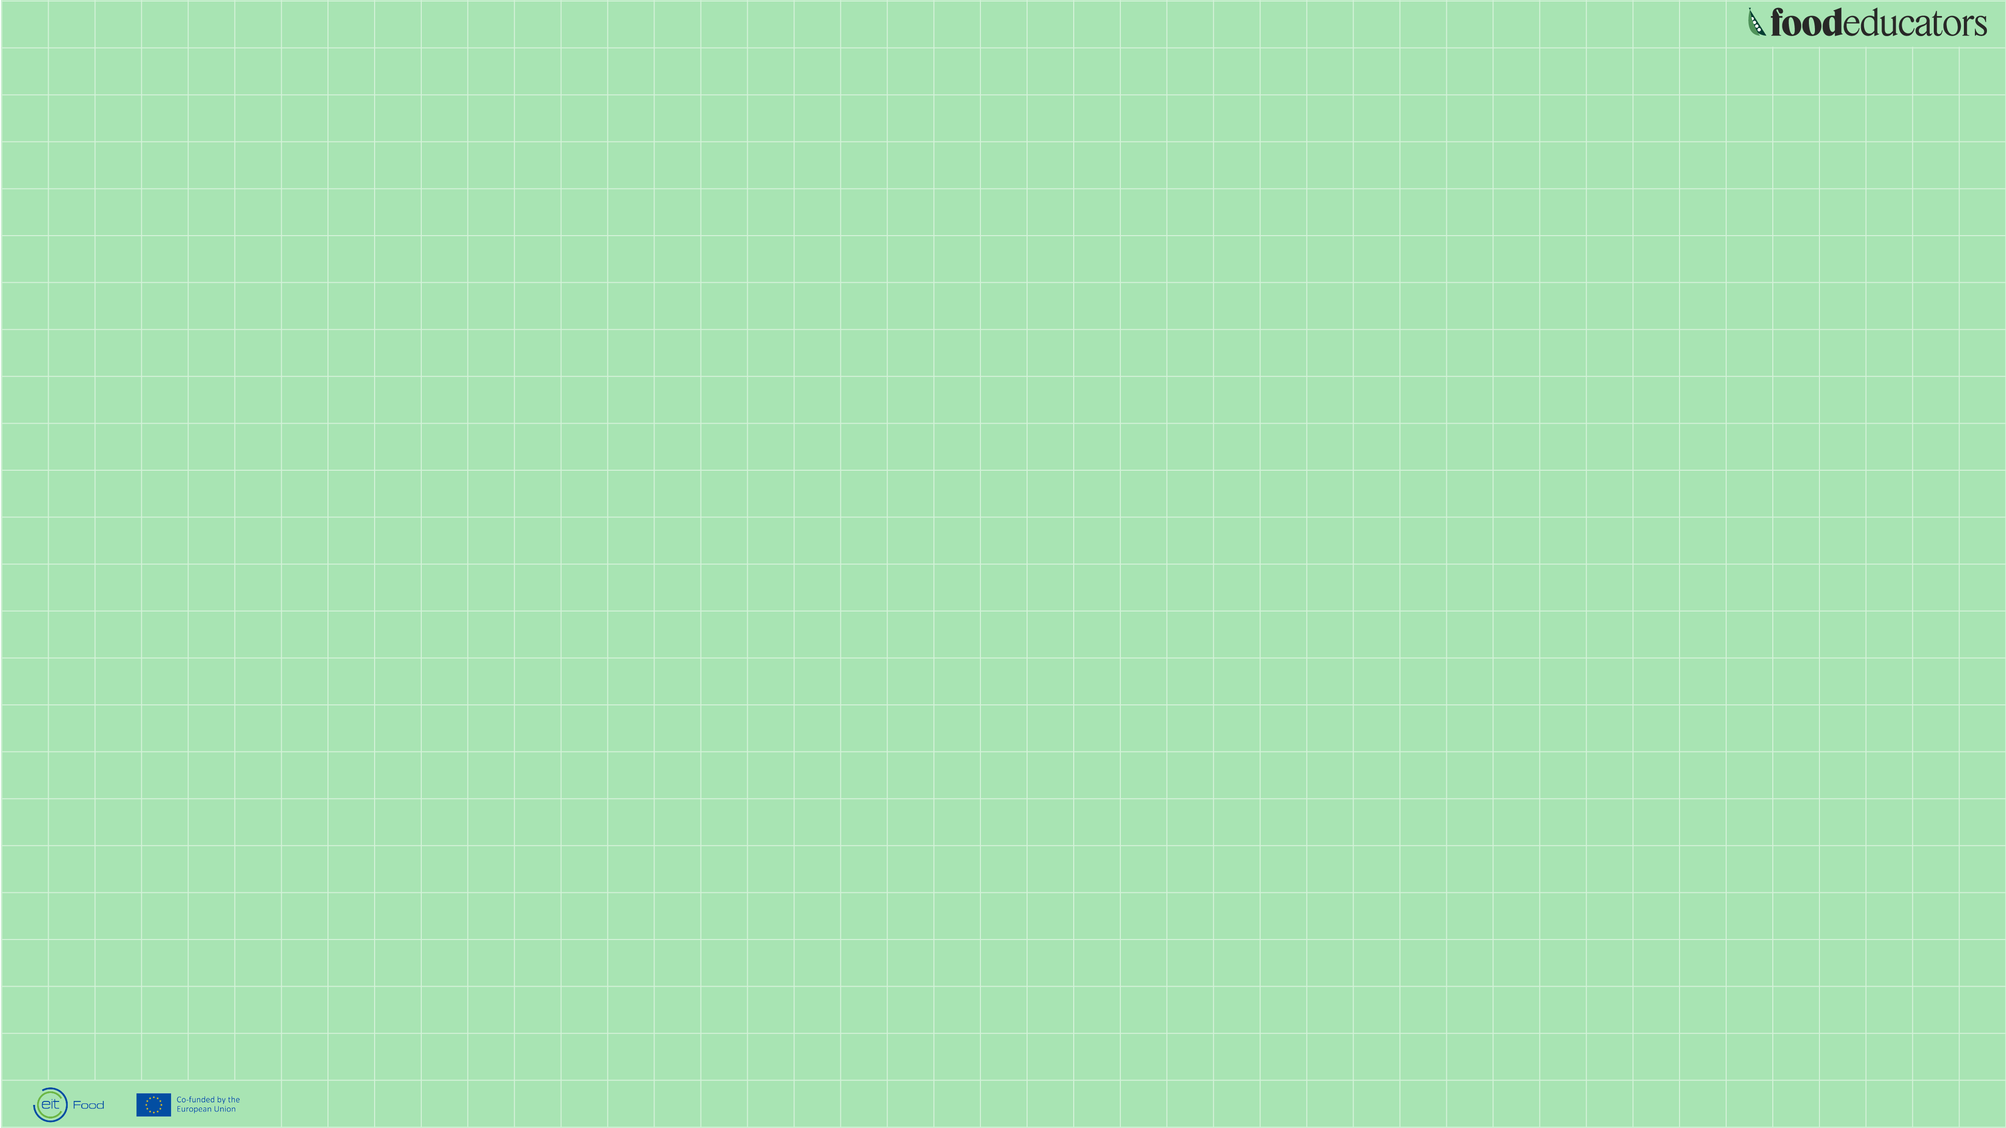
About EIT Food

Slide 15
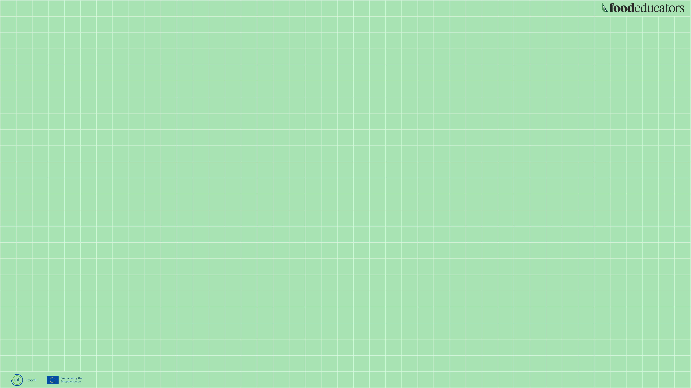
EIT Food is Europe’s leading food innovation initiative, working to make the food system more sustainable, healthy and trusted
by consumers.
Besides entrepreneurship,
public engagement and innovation, one of the focus areas of EIT Food is education, and is currently developing
easy-to-use educational resource packages for teachers on food literacy
and agrifood jobs and careers.

Slide 16

Food System Challenges
At EIT Food we aim to overcome these challenges by bringing all players together
and guiding and accelerating the innovation process to transform the food system.
→ Social
We need to feed 10 billion people by 2050 (UN, 2017)
Over to 2 billion people are currently overweight (WHO, 2018), while 800 million are undernourished (FAO, 2019)
Up to 35% of children under 5 are stunted or overweight (UNICEF, 2019)
→ Environmental
1/3 of our food is wasted globally (FAO, 2019)
70% of global freshwater withdrawals come from the food industry (FAO, 2016)
Food production accounts
for 26% of greenhouse gas emissions (Science, 2018)
→ Entrepreneurial
Only 3.4% of all EU startups are in the food industry (ESM, 2016)
9 out of 10 startups fail due
to lack of a market (Munich Business School, 2016)
Meeting the UN SDGs could
create opportunities worth US $200 billion for the agrifood sector by 2030 (BSDC, 2016)

Slide 17
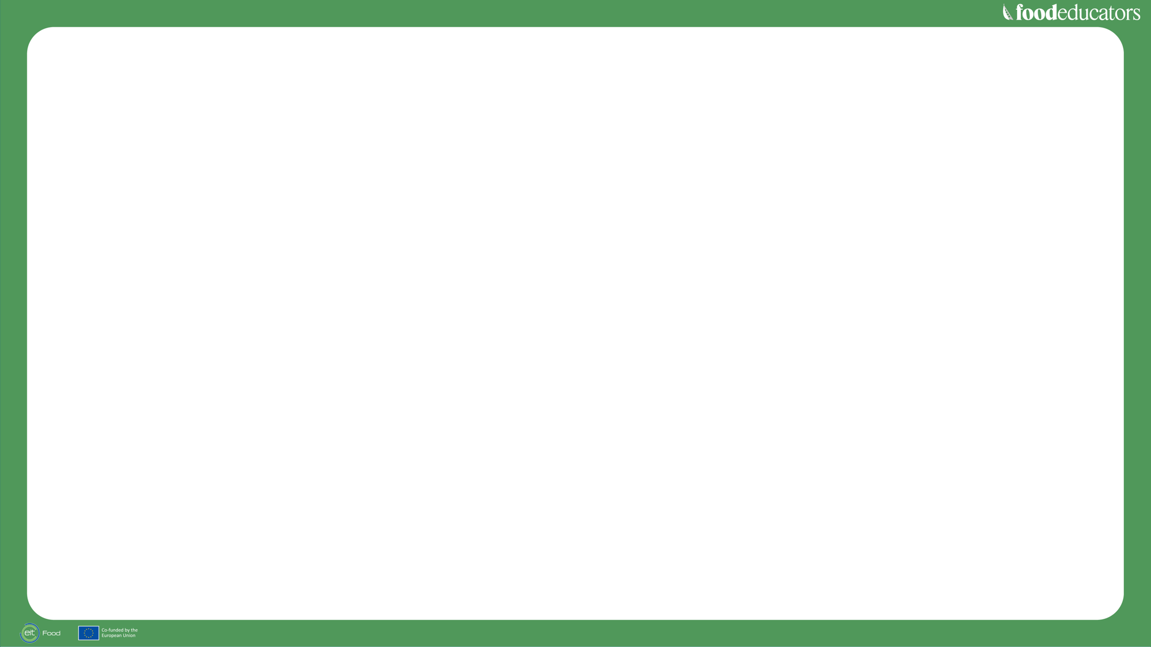
Our Goals
→ Build a community
of informed and engaged consumers who want to change the food system by making healthier and more sustainable choices.
→ Nurture future generations to become connected to the food system, more conscious consumers and passionate about the role of agrifood in safeguarding the planet.
→ Facilitate and open, transparent dialogue and shared sense of purpose between all stakeholders, including consumers, industry, farmers, retailers, scientists, policy makers and consumer organisations.
→ Ensure consumer
are placed at the
centre of food innovation initiatives to increase rates of trust, acceptance
and adoption.

Slide 18
EIT Food’s Public Engagement
At EIT Food, we define Public Engagement as “a set of diverse activities that foster
a two-way dialogue between specialists and the public”. As an organisation, we have
always prioritised the active and important role consumers play in the change we seek.
Public Insights
and Engagement supports
EIT Food’s
missions-based
approach by:
→ Enabling and empowering consumers to make better choices;
→ Influencing food systems transformation policy and business practices through access to consumer insight and surveys;
→ Changing public discourse around food and sustainability, and championing a mindset of transparent and science-based information.
Together, we can change the food system.

Slide 19
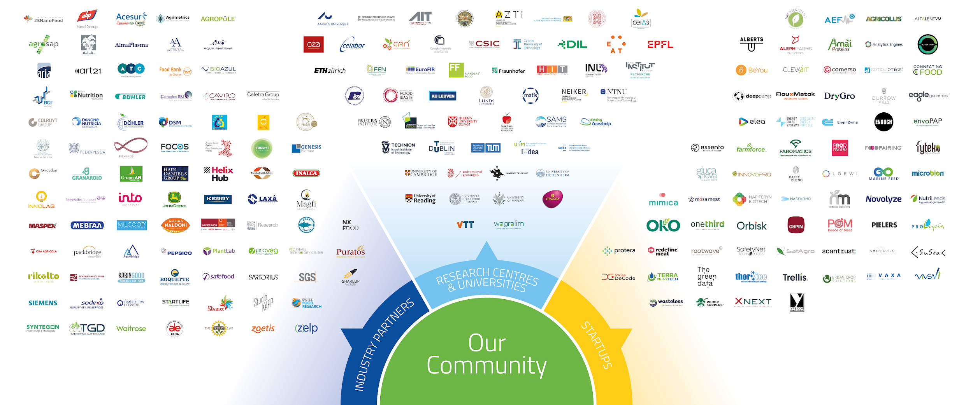
Our Community
Our community is unique because it brings together key players from across the food value chain including industry partners, startups, research centers and universities.

Slide 20

Notes:
Introduce yourself and your organisation
Tell the participants about the house rules:
everyone is muted but they can ask questions after the presentation
they can ask questions in the chat

Slide 21
Our mission
To support educators
to teach, engage and inspire young people about the food they
eat and consider a career in agrifood.
Our vision
A world where young people have access
to food education and are aware of exciting
and innovative agri-
food jobs and careers.

Slide 22
Main learning objectives
→ Systems
mapping
Explore the
variety of jobs within food systems.
→ Healthy
eating
behaviour
Identify the characteristics of healthy eating patterns.
→ Sustainable
lifestyle
Understand sustainability,
from farm to fork to disposal.
→ Systems
thinking
Broadening thinking to identify different elements and understand their interrelations

Slide 23
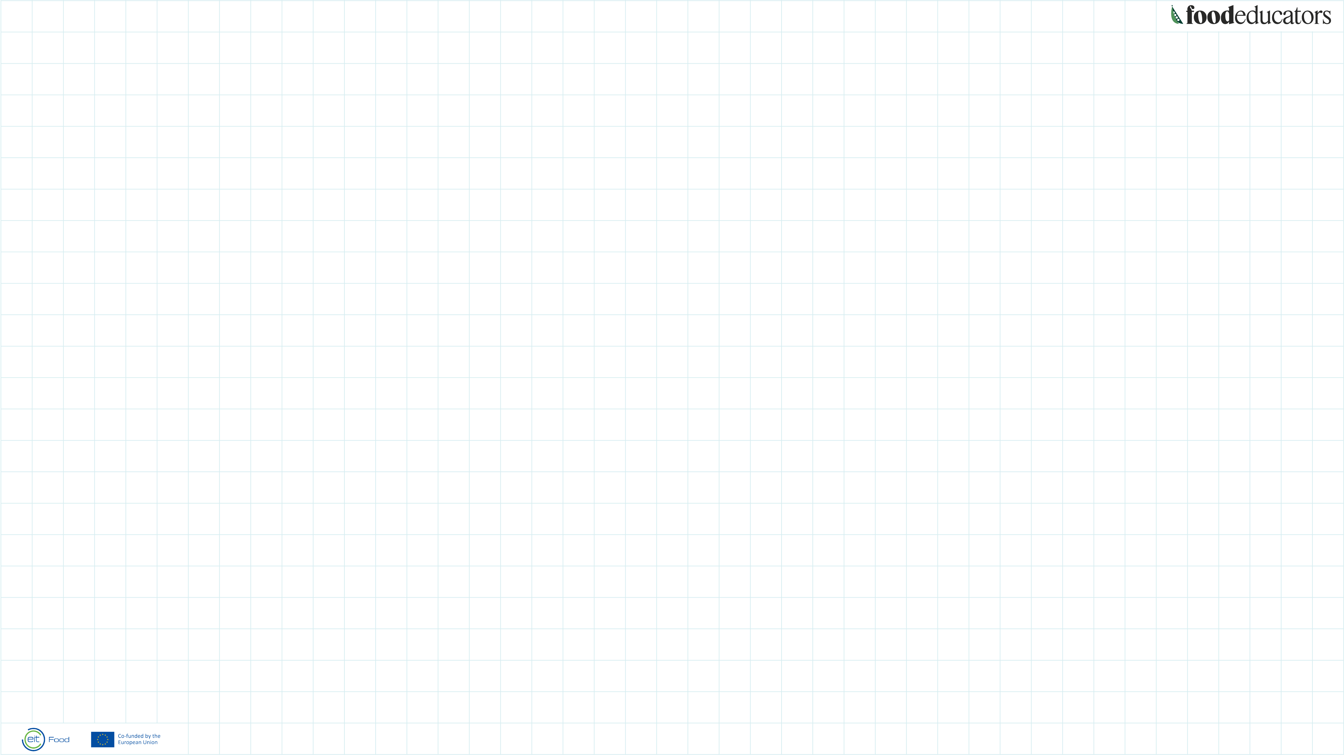

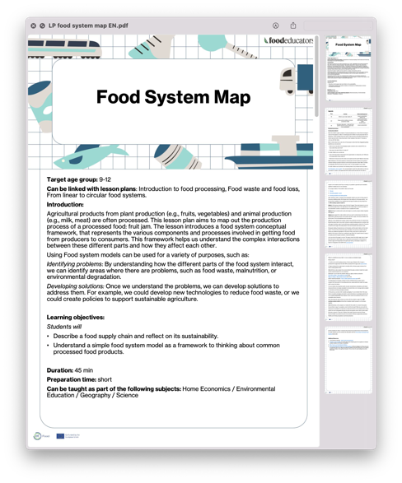
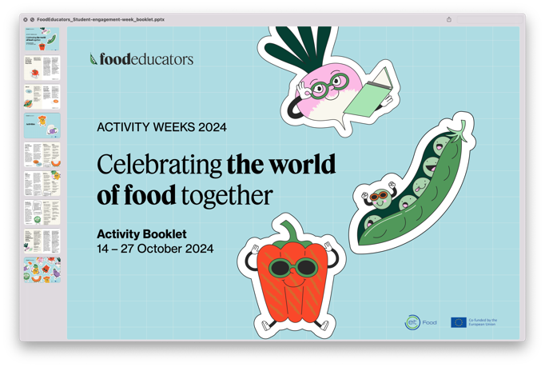
Our offer to educators all around Europe
→ Lesson Plans
Teaching resources materials classed
in 4 themes and available in 16 languages
→ Career Days
Agrifood-related
career days to secondary students
→ Activity weeks
Offering food-related activities around World
Food Day
→ International
FoodEducators
School Network
Network for schools interested in state
of the food education
→ National contact
points
Serving teachers
in their language
in 15 countries

Slide 24
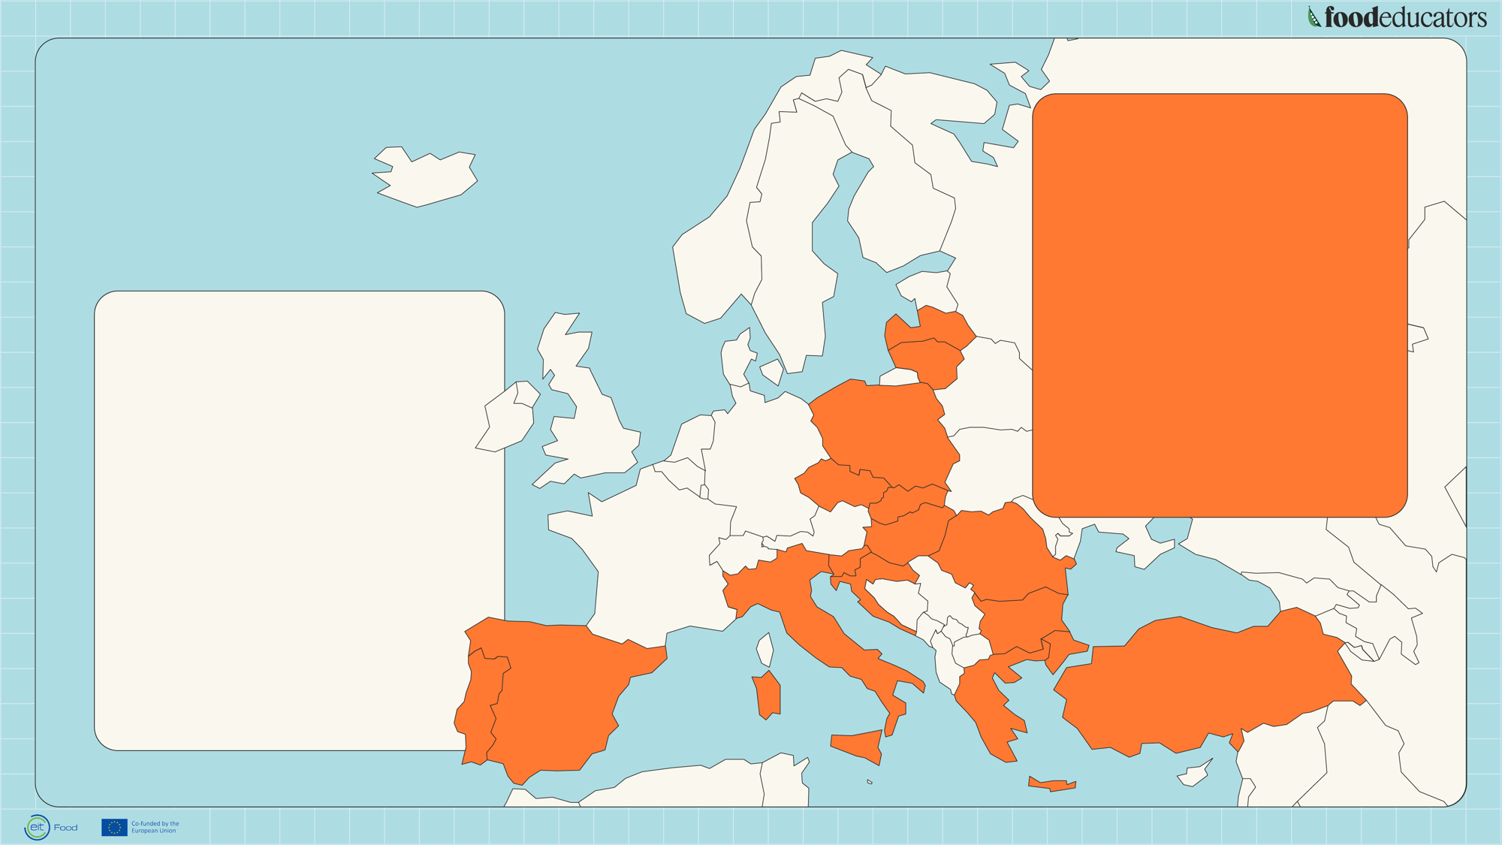
15 Partners
countries
Local HUBs
at national level
→ Local implementation
and promotion
→ Recruitment and
workshops for teachers
→ Implementing agrifood
career days and organising
events
Resources Center
at European level
→ Representation on EU-level
→ Organizing the community
and building partnership
→ Managing Teachers’
Advisory Board
→ Communication
and content creation

Slide 25
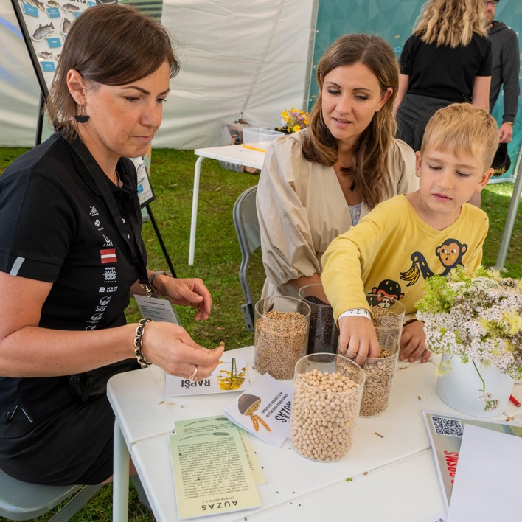
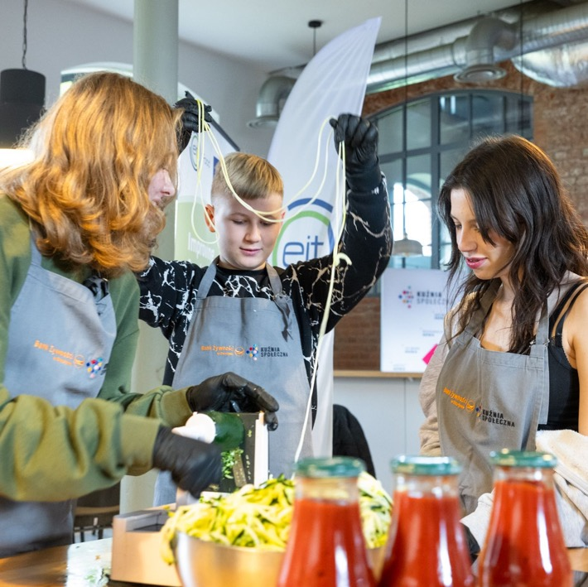
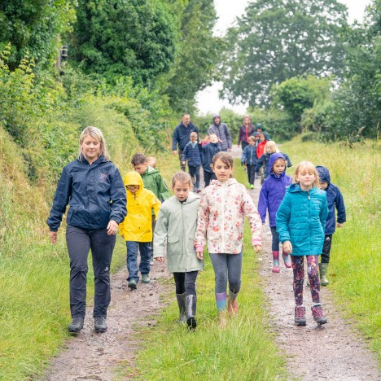
Student Workshop in
Poland, Olsztyn, IARFR
National Primary Competition in
England, LEAF Education,
Latvia, Latvian Rural Education
and Consultation Center

Slide 26

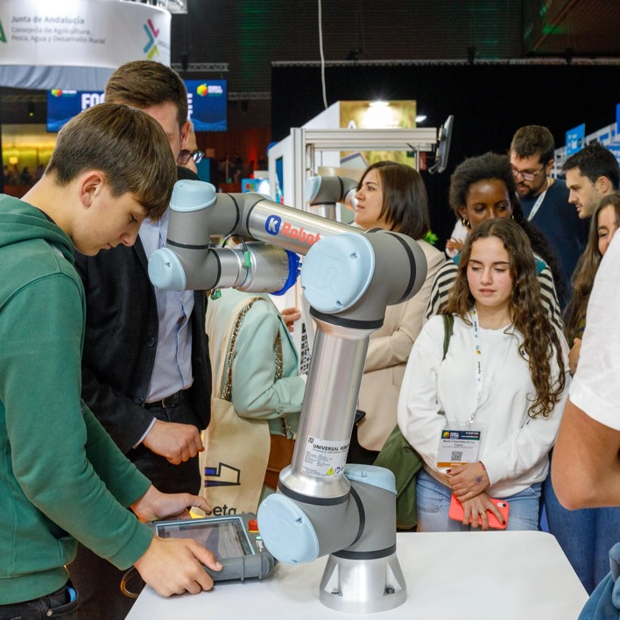
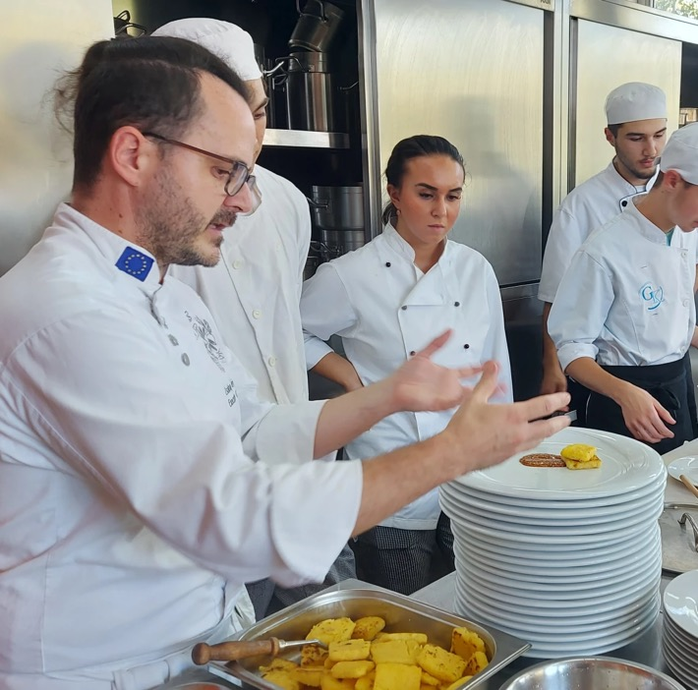
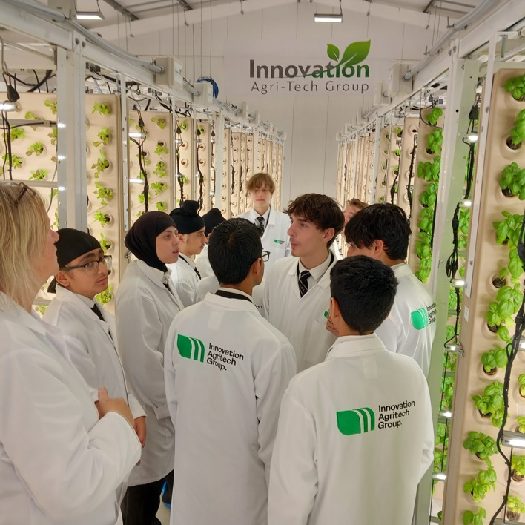
Career Day in Portugal,
Bilbao, Future 4 Food
Farm visit in England,
Bracknell, LEAF Education
Student workshop in Hungary, Budapest, Planteen

Slide 27

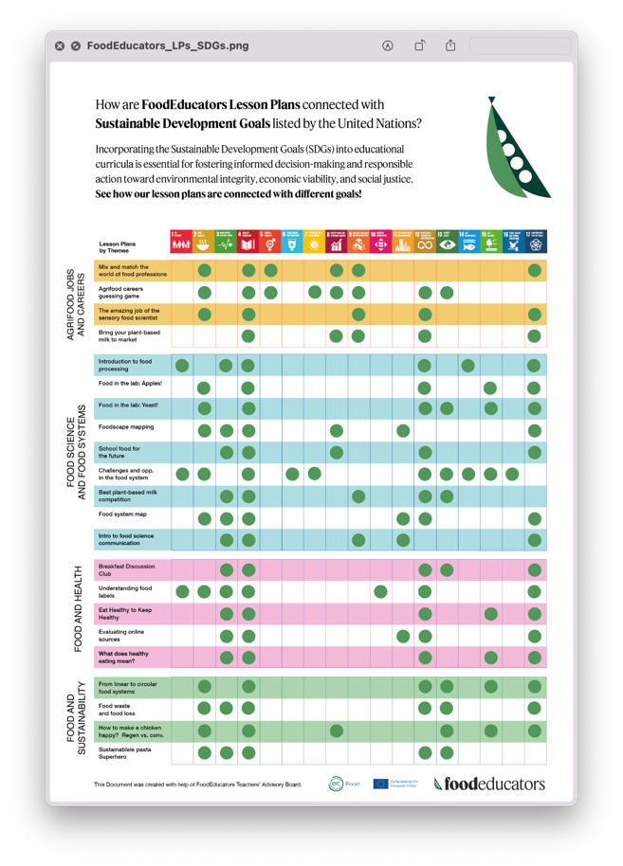
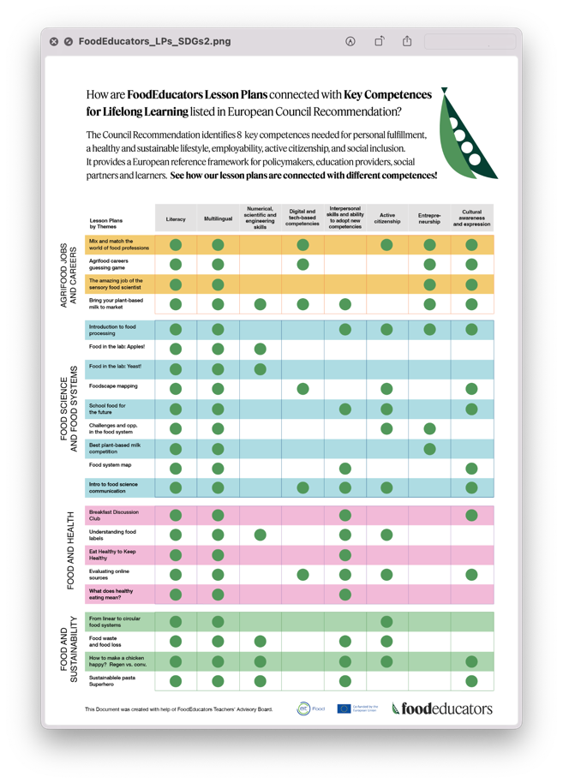
About our lesson plans
√ Downloadable lesson plans
√ Online tools, videos, handouts,
supporting materials
√ Target group: 6-18 years
√ Focusing on critical and
systems thinking skills
√ Challenge-based
√ Cooperative, action-oriented,
playful
√ Employing multimedia content
Notes:
Dear presenter!
This is a slide deck for the FoodEducators info webinar, but can also be used as an introduction to the teachers' training. Feel free to modify, omit or add more slides (of course, always adhering to the FoodEducators brand!)
The length of the info webinar is 1.5 hours, 2 hours max, pace accordingly.

Slide 28
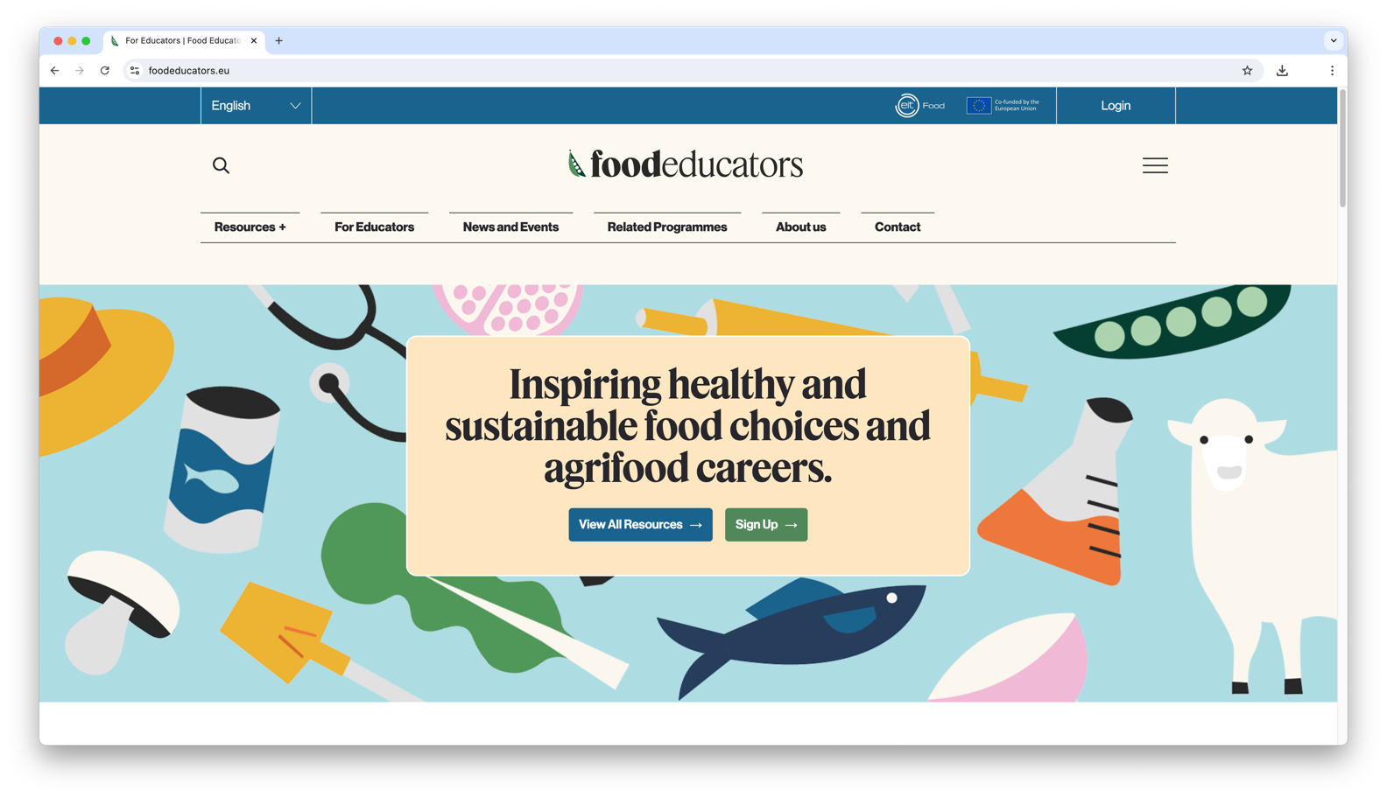

Slide 29

Link to the video

Slide 30


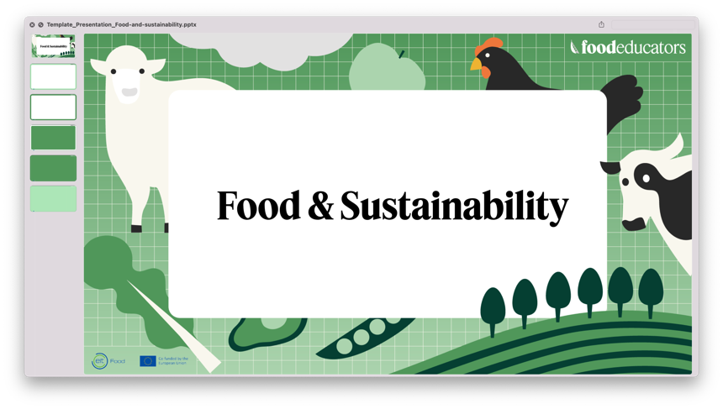


Slide 31


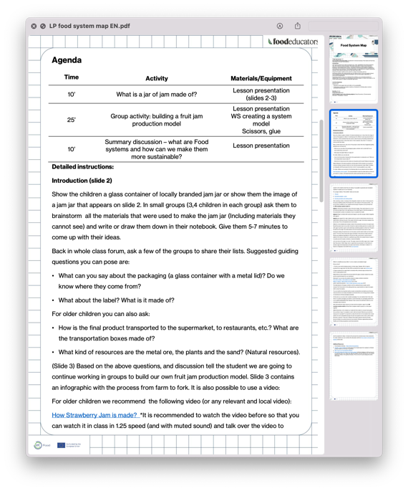
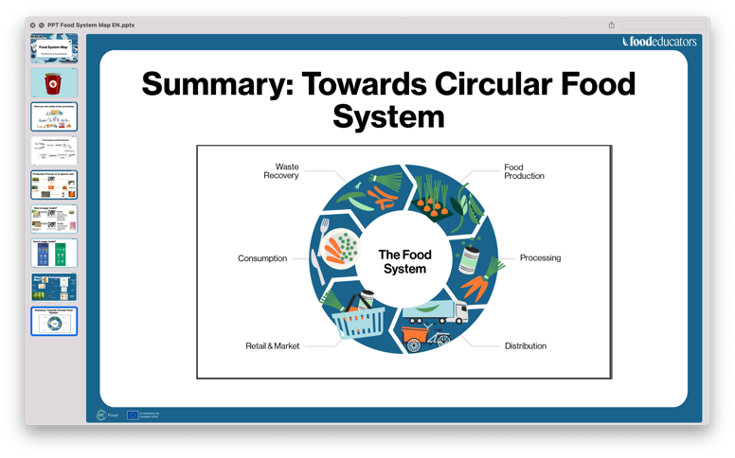
How to use our
Lesson plans

Slide 32
Discussion about
Implementation
and Q&A

