Slide 1
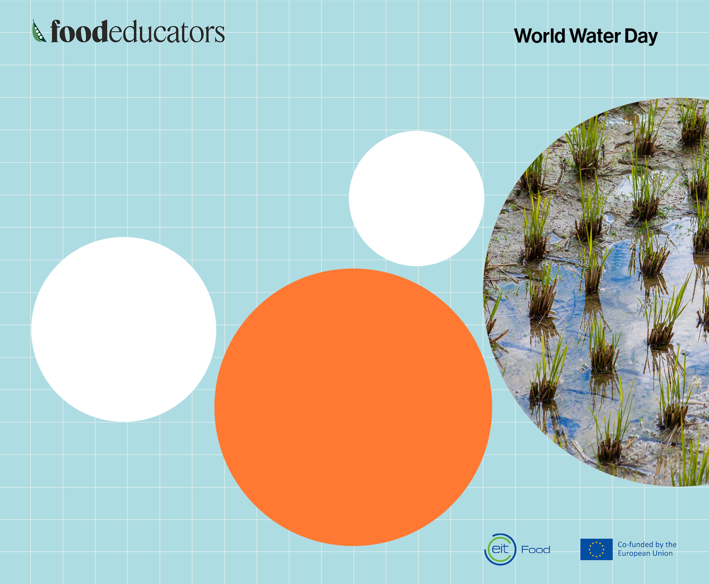
The water footprint
of our food
in litres used per kilo of food
Potatoes
500 litres
Rice
5000 litres
Wheat
900 litres
Beef burger
2000 litres
Source: WWF

Slide 2
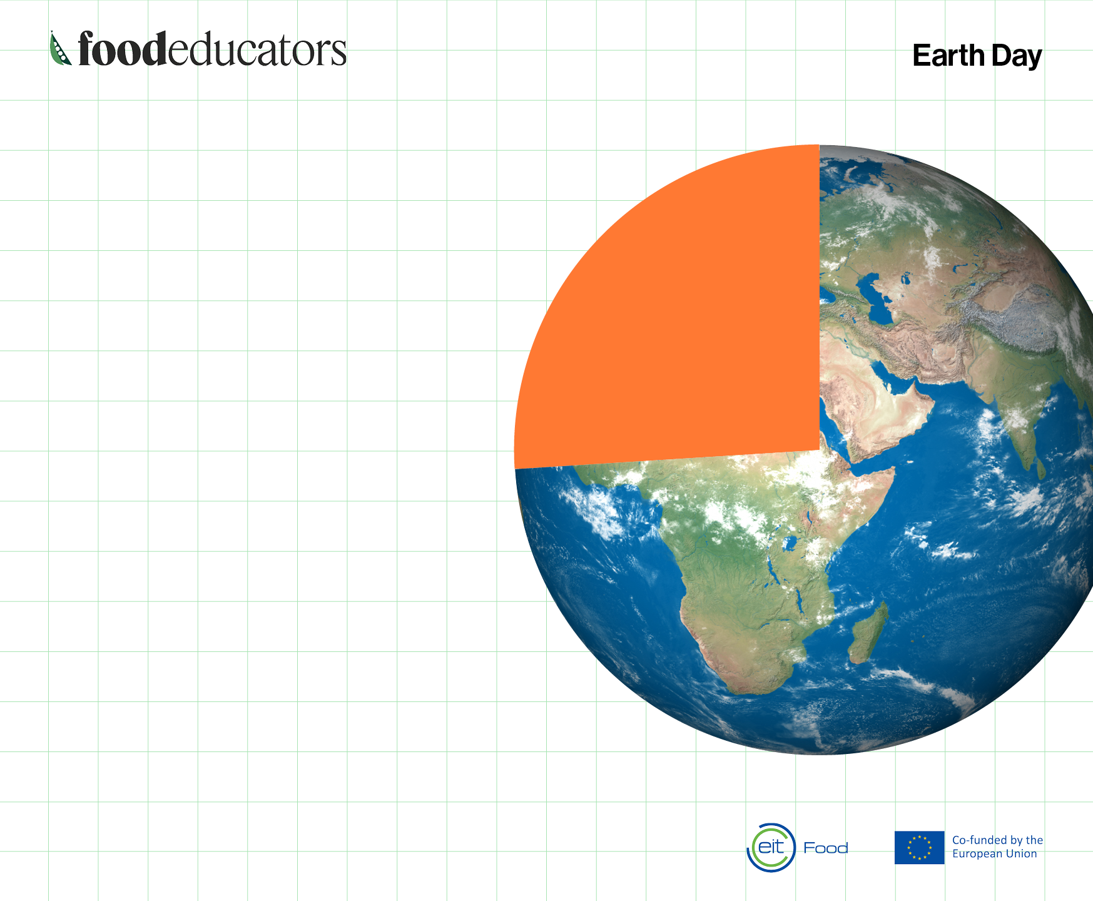
Around one-third
of human-caused
greenhouse gas
emissions are
related to food.
This #EarthDay, we’re
celebrating healthy and
sustainable food choices!
Source: WWF

Slide 3
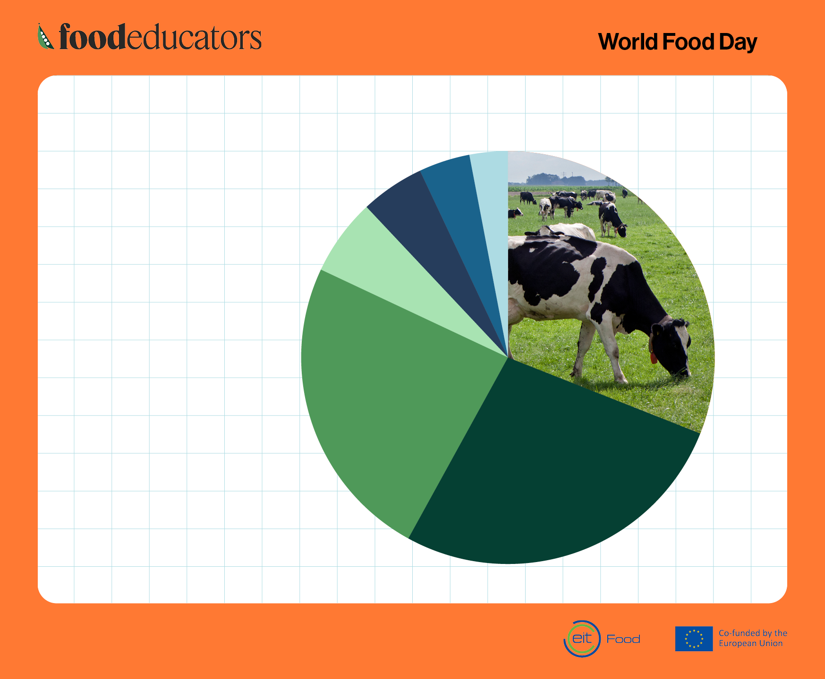
Where do food
emissions
come from?
LIVESTOCK AND FISH FARMS 31%
RETAIL 3%
PROCESSING 4%
PACKAGING 5%
TRANSPORT 6%
CROP FARMING
27%
LAND USE 21%
Source: Poore & Nemecek (2018) Science.

Slide 4
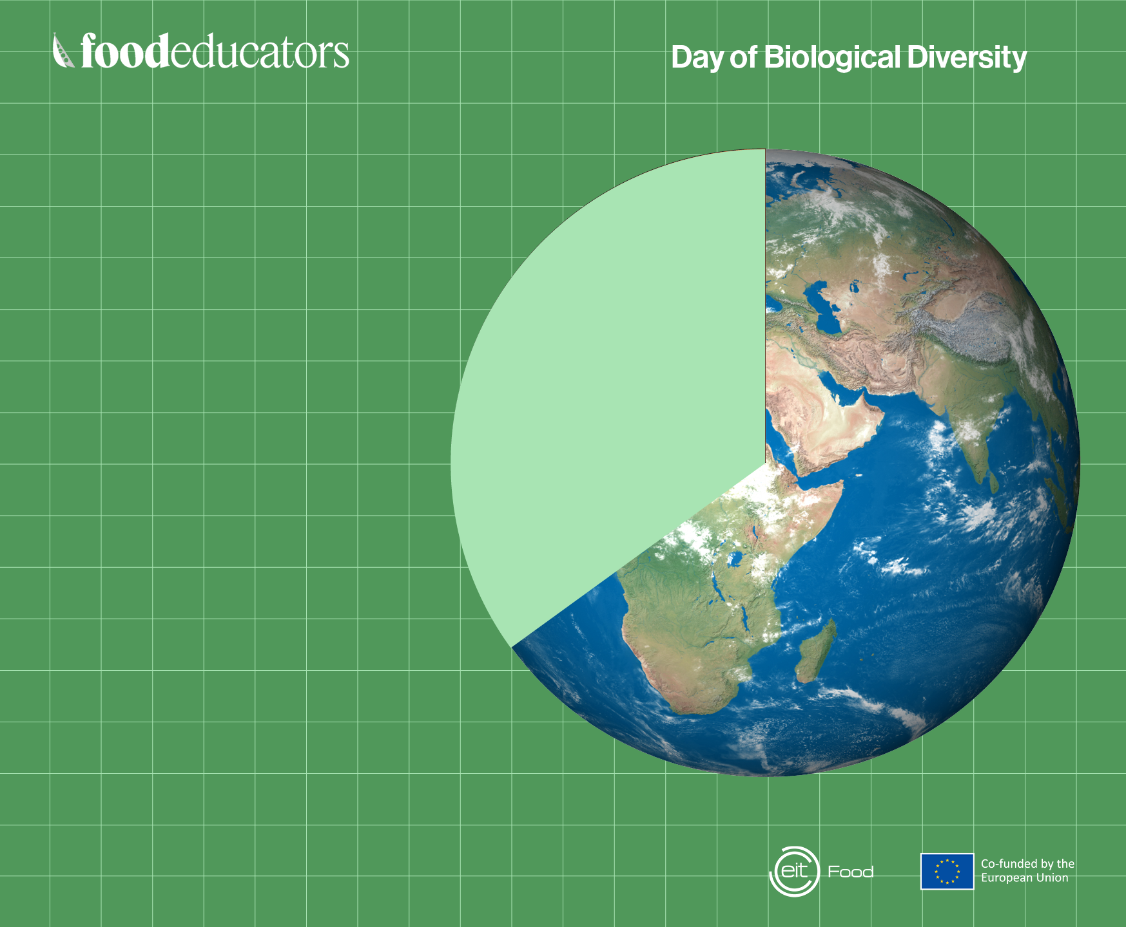
Why biodiversity
is important
for food
Around 35% of global
food production depends
on pollination by animals,
such as bees, birds, and
bats. This includes most fruits,
seeds, and nuts, as well as some
commercially valuable crops.
Source: WWF

Slide 5
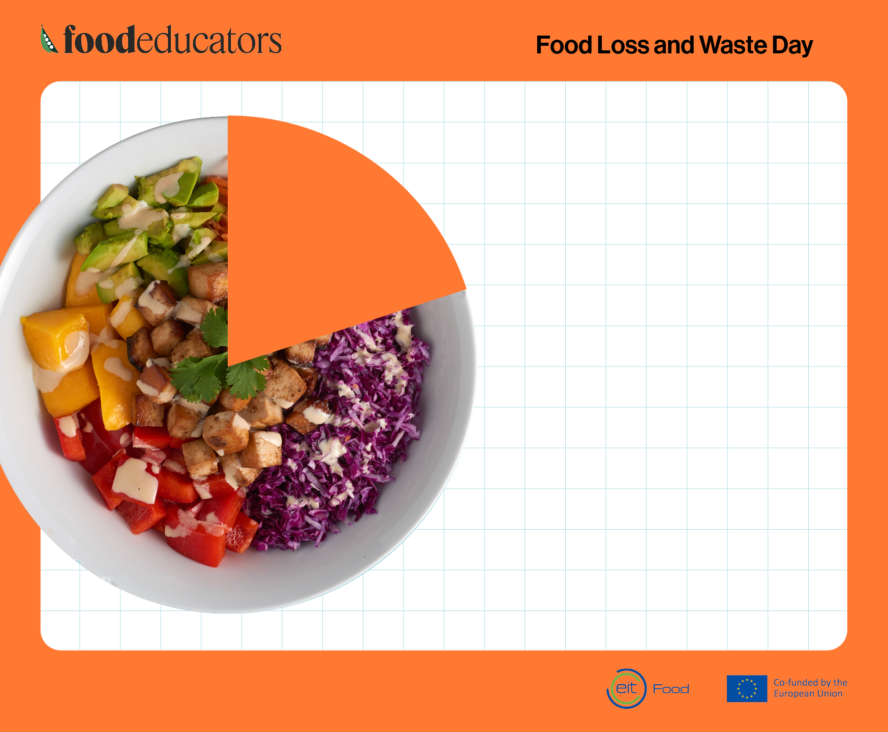
One-fifth of food
produced is
lost or wasted
globally.
Sixty percent of that
waste happens at
the household level.
The total cost of food
loss and waste globally is
estimated at roughly €1 trillion.
Source: UNEP Food Waste Index Report 2024

Slide 6
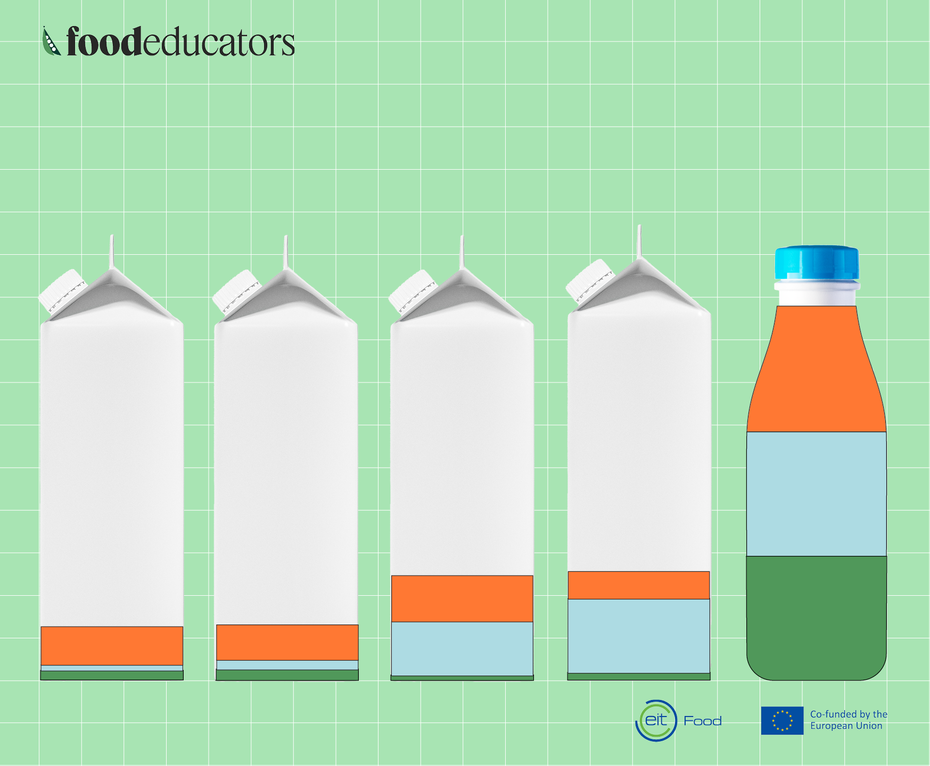
What’s the most
sustainable milk?
GHG Emissions kg CO2 eq.
Water Use L
Land Use m²
COW
SOY
OAT
RICE
ALMOND
Source: Poore & Nemecek (2018) Science.

Slide 7

Jajecznica i Kanapki
Poland
Fry up
England
Kahvalti
Turkey
Cornetto
Italy

Slide 8
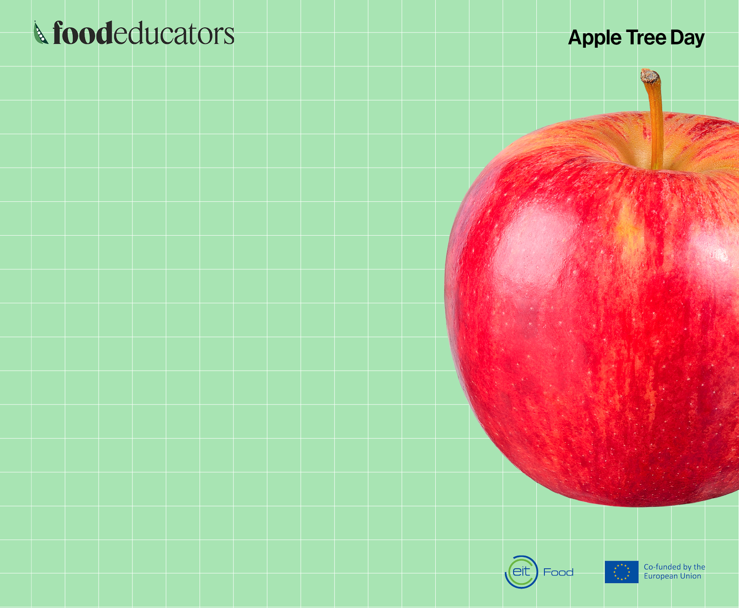
Did you know that
a mature apple
tree can produce anywhere from
100 to 1,200 apples
per season?
To celebrate the Apple Tree Day, we’ll
be using Food Educators lesson plans!

